Slide 1

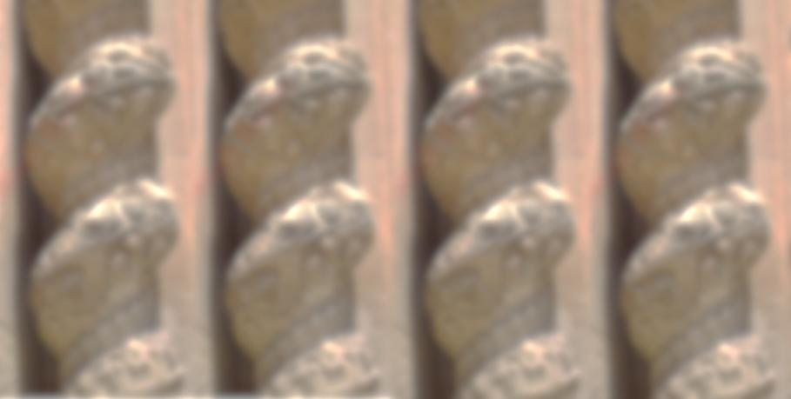



Waking up in Baroque
ERASMUS+ - 2017-1-CZ01-KA219-035444_4
Istituto di Istruzione Superiore
Palazzolo Acreide
ROSARIO GAGLIARDI
Architect and Builder
in the Baroque Age
Final Exchange 2019
NERATOVICE, CZECH REPUBLIC

Slide 2

Rosario Gagliardi
(1698–1762)
Rosario Gagliardi was born in Syracuse in 1698.
He was one of the leading architects working in Sicily
in the Baroque period.
Though he had never left Sicily his work showed a great understanding and interpretation of the Baroque style
as conceived by Bernini.

Slide 3
Gagliardi contributed to the construction of such amazing buildings which equal Bernini’s works in craftsmanship, sumptuousness and magnificence.
He worked mostly in Modica.

Slide 4
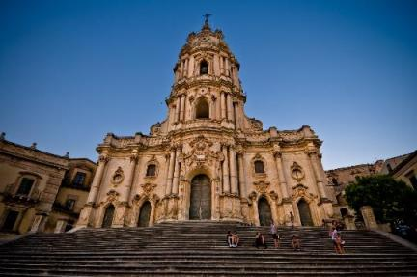
THE CATHEDRAL OF SAINT GEORGE - MODICA
Rosario Gagliardi was one of 18th century valuable architects who continuously worked on most of the buildings in South-eastern Sicily
after the1693 earthquake which destroyed most of the towns on the island.
He designed the initial project of the cathedral
of St. George and its façade.
The imposing "tower" façade was built at the beginning of 1702 and completed in 1842 with the final crowning and with the apposition of an iron cross on the spire.

Slide 5
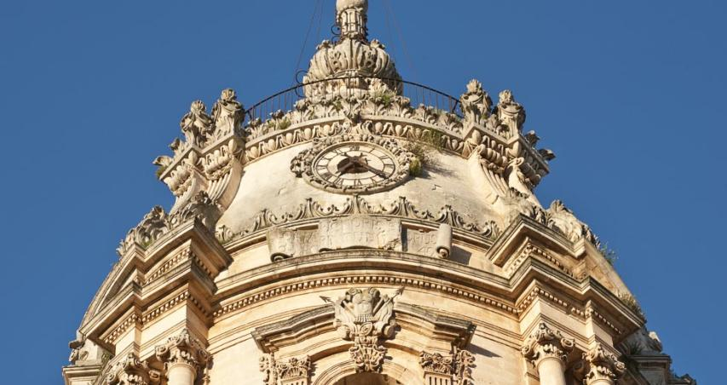

Slide 6
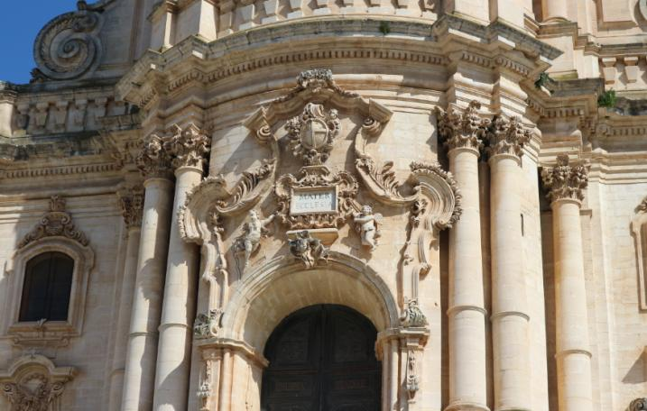

Slide 7
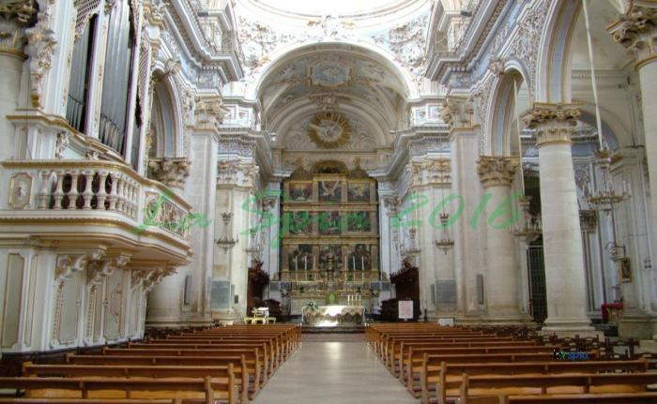

Slide 8
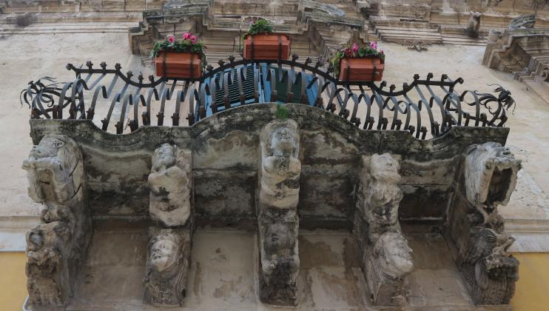

Slide 9
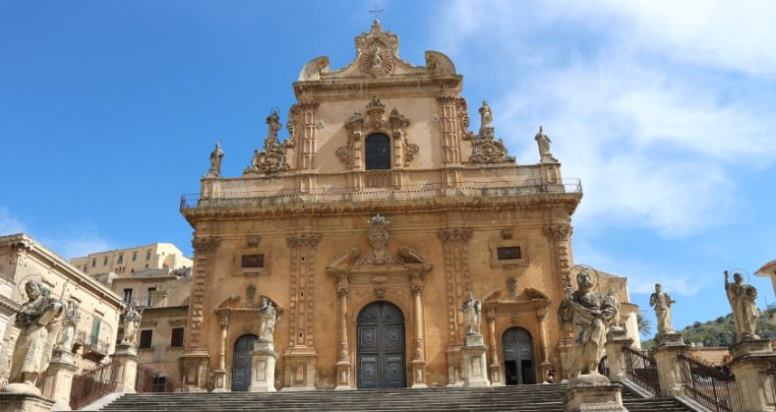

Slide 10
The Church of St. George is thought to be the prototype for all the other churches in the region

Slide 11
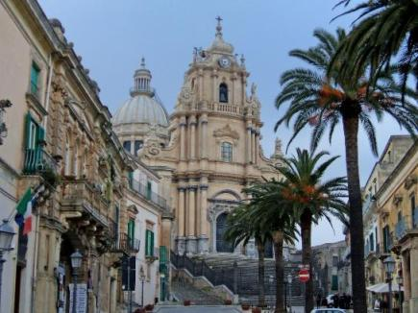
THE CATHEDRAL OF SAINT GEORGE – RAGUSA IBLA
Gagliardi was also responsible for the whole project of the domed Cathedral of St. George in Ragusa which was designed in 1738 and built in 1744.
Its beautiful concave-convex facade is enclosed with a high wrought iron railing made by the craftsman Angelo Paradiso.

Slide 12
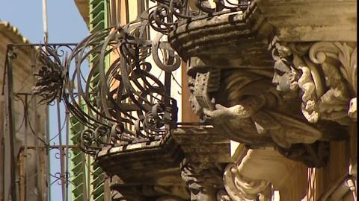
THE BAROQUE – RAGUSA IBLA

Slide 13
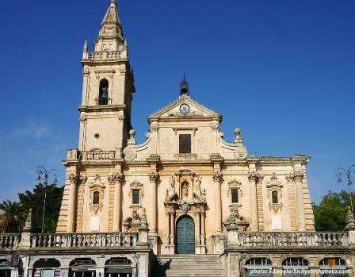
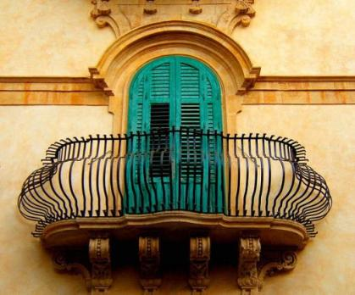
THE BAROQUE – RAGUSA

Slide 14
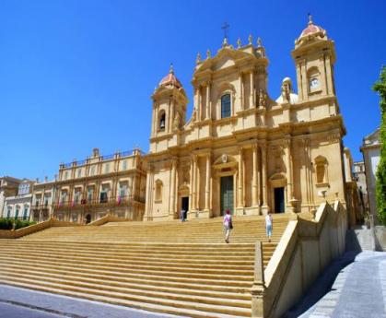
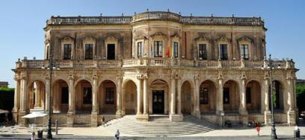
THE BUILDINGS AND CHURCHES IN NOTO
Other works
Gagliardi built numerous other churches and buildings in Noto and in other places on the island.

Slide 15
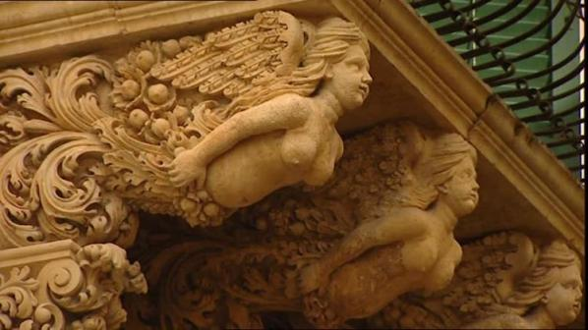
THE BAROQUE IN NOTO
Gagliardi captured the sunny features of this style and created an astonishing exhibition of Baroque motifs carved on the white stones of some buildings and churches.
All his works are fully decorated with wonderful stuccos, rich stone embroideries, flowery carvings, columns, statues and bright colours.
He died in Noto in 1762 at the age of 64.

Slide 16
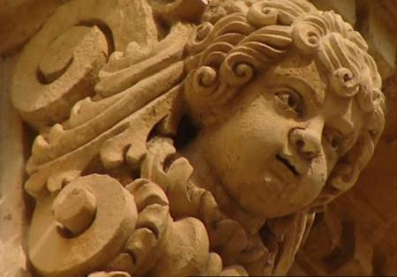
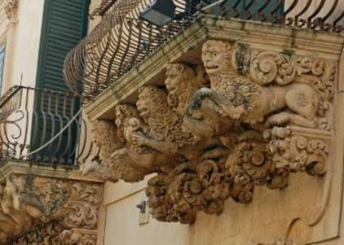
THE BAROQUE IN NOTO

Slide 17
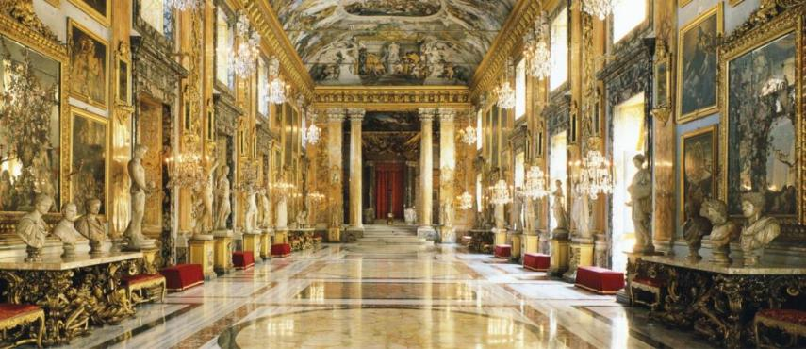
THE BAROQUE IN NOTO

Slide 18


See you in Sicily for your holidays

