Slide 1
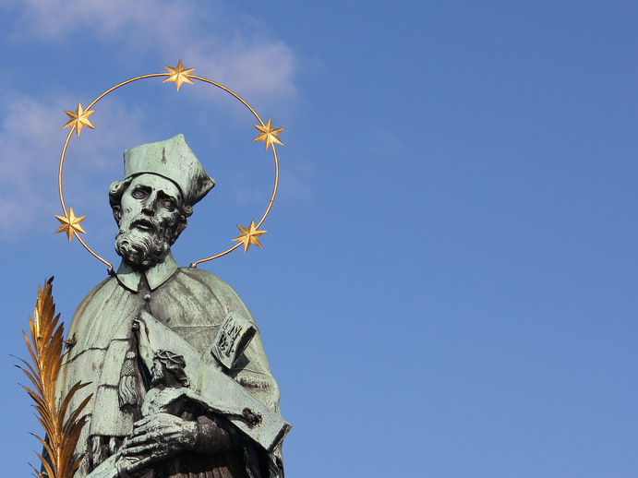

John of Nepomuk
Jan Nepomucký

Slide 2
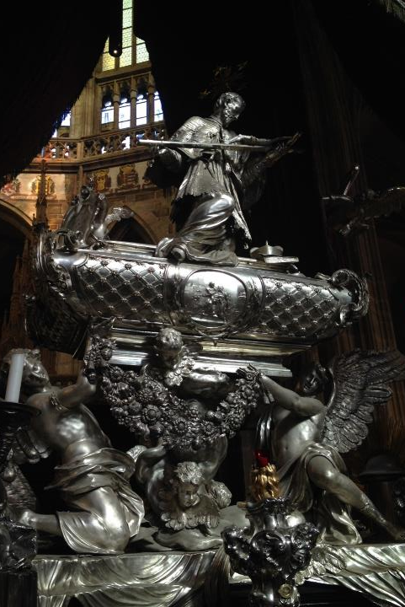


Basic information born 1340s died 1393
Vicar - general of
Jan of Jenštejn
His tomb - St. Vitus Cathedral, Prague
Drowned in the Vltava river
Protector from floods and drowning
The cult - Central Europe (statues, commemorative plaque, churches…)

Slide 3
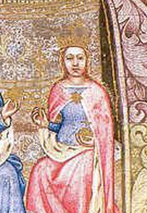


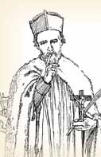

Sophia of Bavaria
Sofie Bavorská
John of Nepomuk
Jan Nepomucký

Slide 4
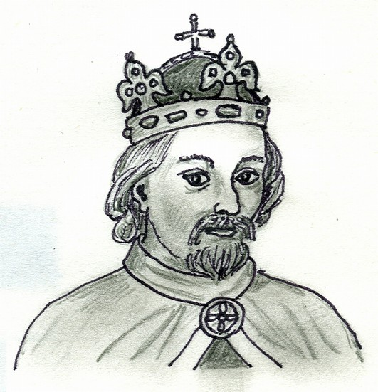

Wenceslas IV
Václav IV.

Slide 5


!
!

Slide 6
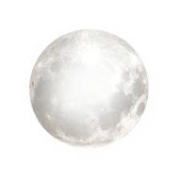
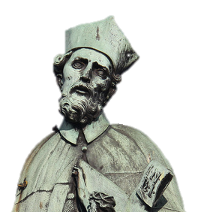

Slide 7
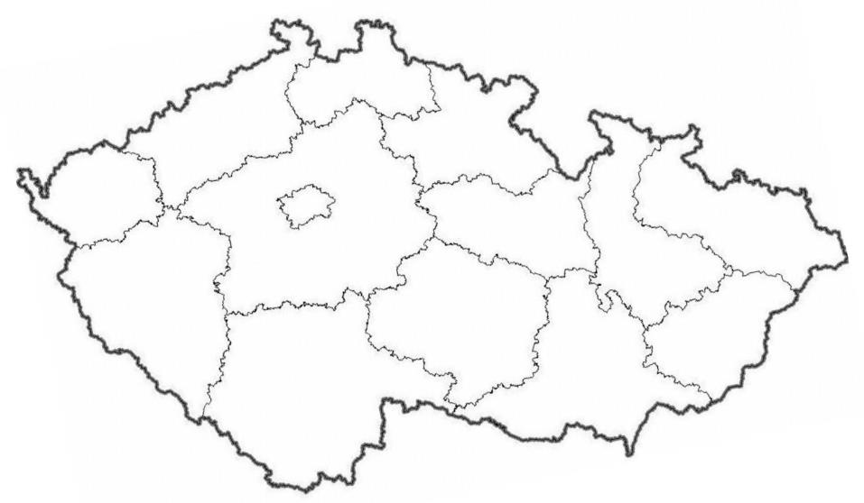
400+ locations
Prague
Ostrava
Brno
Notes:
Mention that this is the map of the Czech regions!
Click and show some places

Slide 8
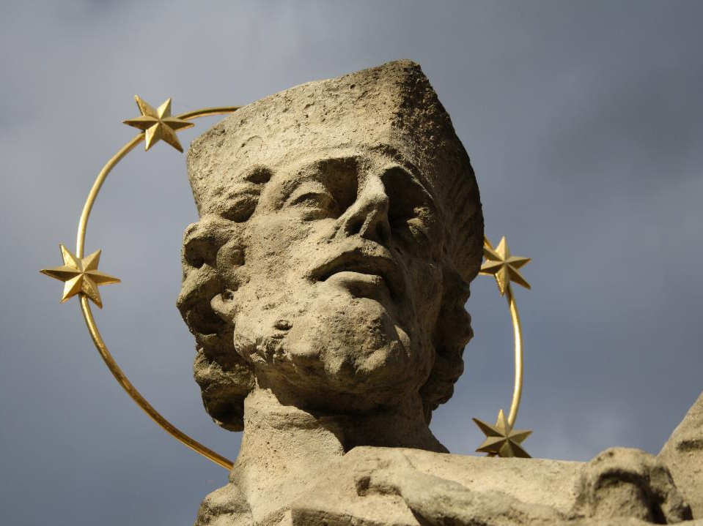
halo of 5 stars

Slide 9
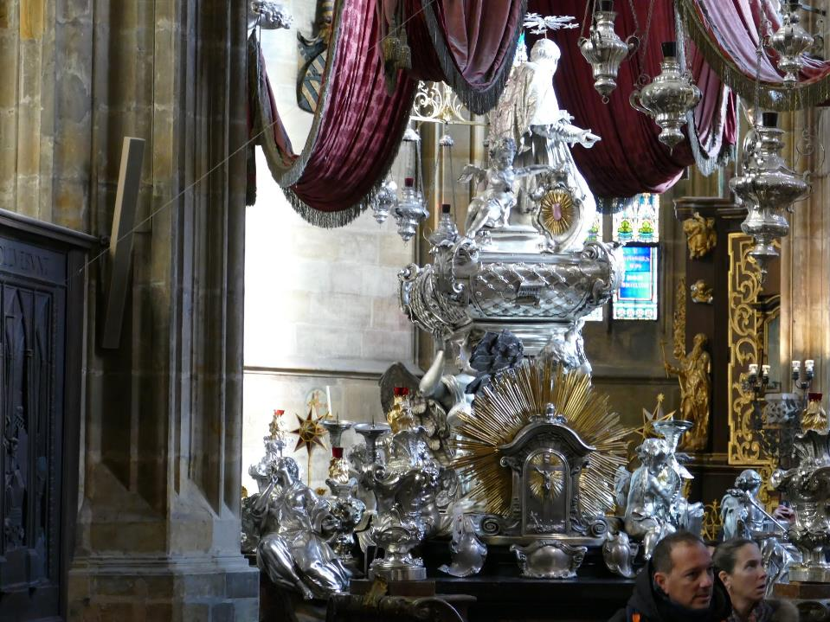
St. Vitus
Cathedral
Prague

Slide 10
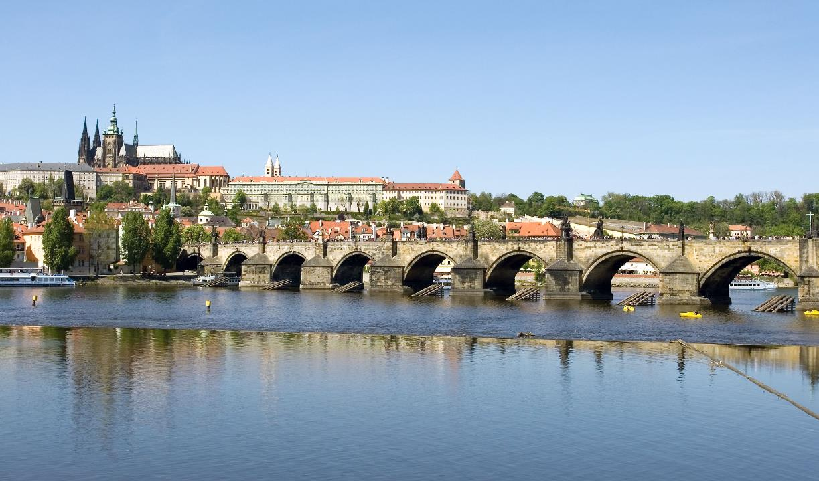
Charles Bridge
Prague

Slide 11
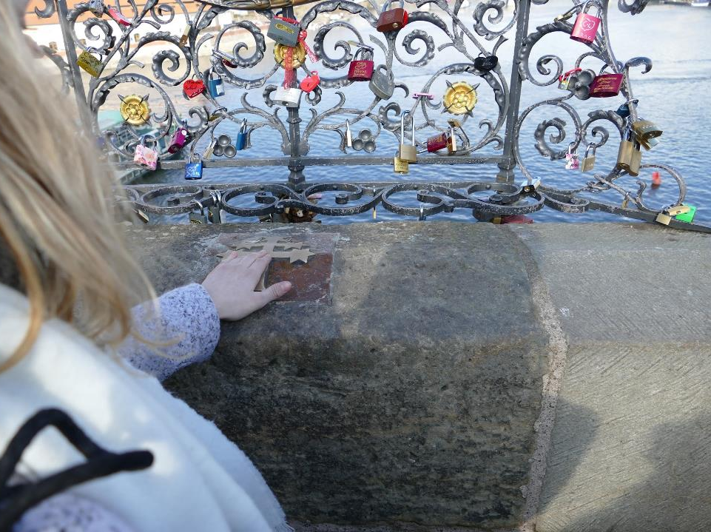

Slide 12
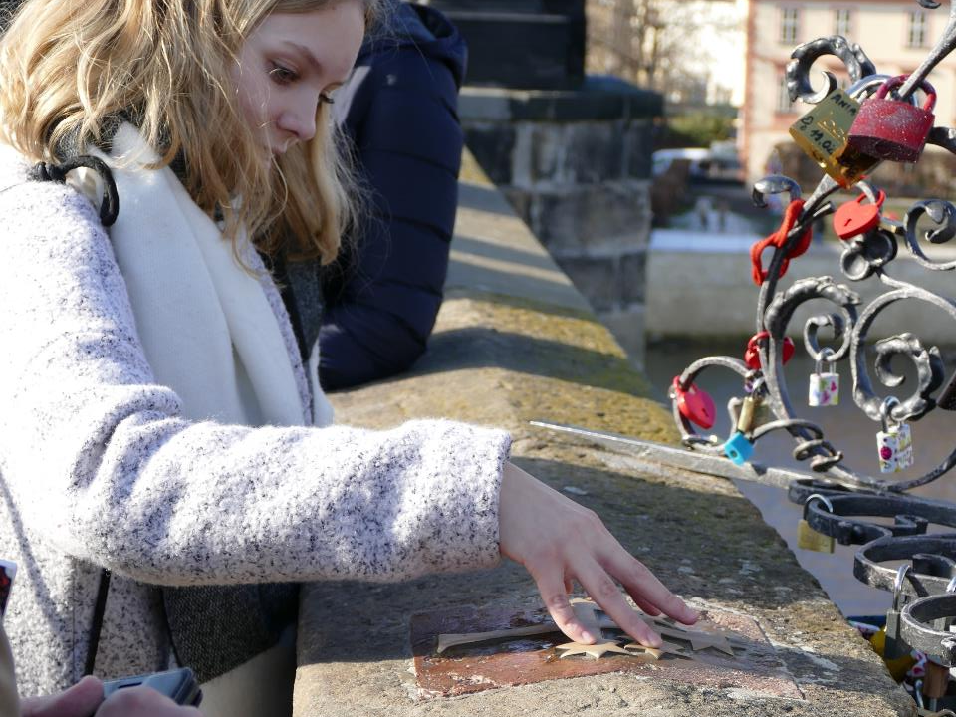

Slide 13
This is the end of the presentation

Slide 14
https://play.kahoot.it/#/lobby?quizId=8933b861-842d-468e-b342-76dac94fad43
KAHOOT.IT

Slide 15
Sources
https://i.pinimg.com/originals/39/dd/68/39dd682f5e26a242b3d258ae05d92286.jpg
http://www.digital-guide.cz/media/cache/8c/4f/8c4ff43e9ae366e68ba220d357478a71.jpg
https://salemnet.vo.llnwd.net/media/Christianity/HistoryTimeline/10516.jpg
https://c1.staticflickr.com/8/7426/11762128736_2e473a0049_b.jpg
https://cdn.pixabay.com/photo/2016/03/31/19/13/broken-heart-1294820_640.png
https://d30y9cdsu7xlg0.cloudfront.net/png/42025-200.png
https://orig00.deviantart.net/05db/f/2014/212/0/b/bright_full_moon_png_by_clairesolo-d7t4mdm.png
https://upload.wikimedia.org/wikipedia/commons/b/b8/Tomb_of_John_of_Nepomuk%2C_Prague.JPG
https://upload.wikimedia.org/wikipedia/commons/6/67/Head_of_statue_of_John_of_Nepomuk_in_T%C5%99eb%C3%AD%C4%8D%2C_Czech_Republic.jpg
https://upload.wikimedia.org/wikipedia/commons/8/80/Charles_Bridge_-_Prague%2C_Czech_Republic_-_panoramio.jpg
https://ayankeeinprague.files.wordpress.com/2013/03/img_0933.jpg
https://upload.wikimedia.org/wikipedia/commons/a/a2/Celakovice_Jan_Nepomucky_1.jpg

Slide 16
Sources
http://www.vybezek.eu/images/stories/a15/ivo/2015/04/sloup_skalice_nepomucky/DSC_0292.JPG
http://bubinga.blog.cz/1406/sochy-sv-jana-nepomuckeho-v-karlovych-varech
http://previous.npu.cz/download/1304497540/1.+Plze%C5%88.+Socha+sv.+JN.+Stav+v+roce+2006.+Foto+VK.jpg
http://www.kaplicky-trebonsko.cz/img/1257b.jpg
http://www.dedictvivysociny.cz/files/_legacy466/thumb-o/p1010581.jpg
https://foto.turistika.cz/foto/r/700/50616/60386/full_082a19_SAM_1681.JPG
https://foto.turistika.cz/foto/r/550/13416/65366/full_b82488_bpc260032.jpg
https://upload.wikimedia.org/wikipedia/commons/thumb/5/5c/John_of_Nepomuk_statue_in_Olomouc.jpg/682px-John_of_Nepomuk_statue_in_Olomouc.jpg
https://foto.turistika.cz/foto/r/800/80865/53958/full_eebfef_P8040008.JPG
http://www.brno-bohunice.cz/galerie/421638.jpg
https://foto.turistika.cz/foto/r/550/208048/102582/lrg_img_0186.jpg

Slide 17
Sources
http://www.msjn.cz/cs/atributy-svateho-jana-nepomuckeho
Add more sources here!

Slide 18
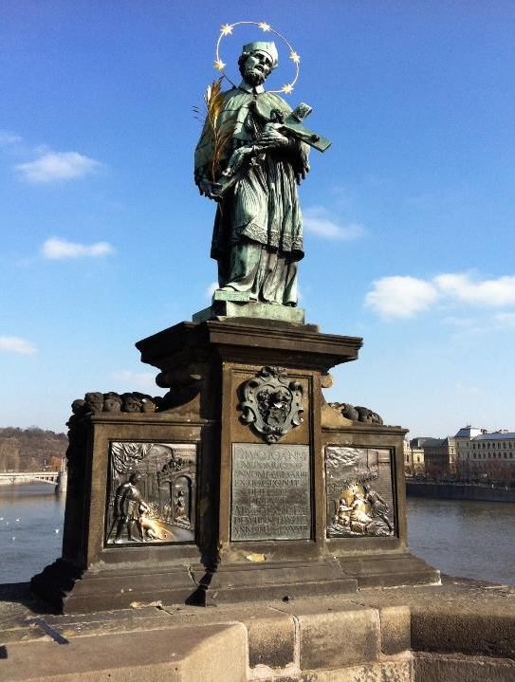
Prague
Charles Bridge

Slide 19
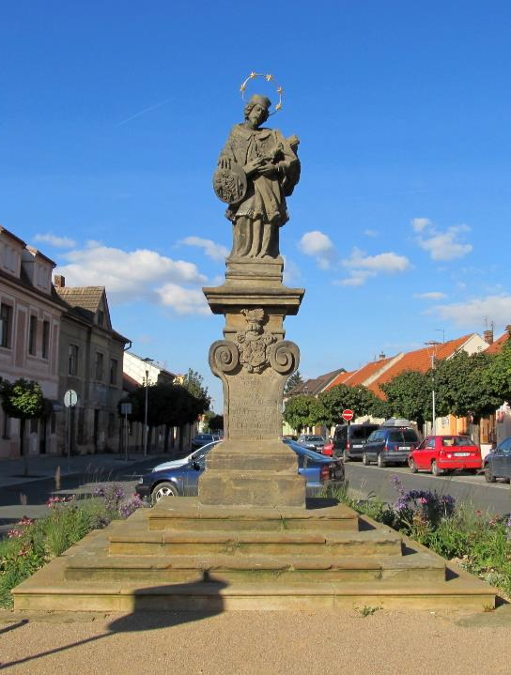
Čelákovice

Slide 20
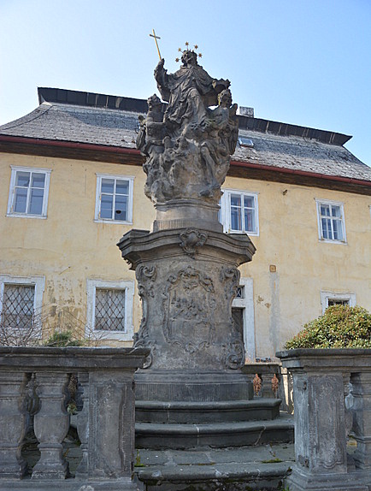
Skalice u České Lípy

Slide 21
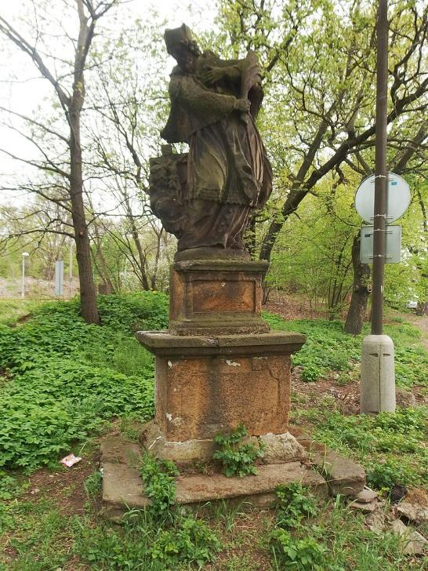
Chomutov

Slide 22
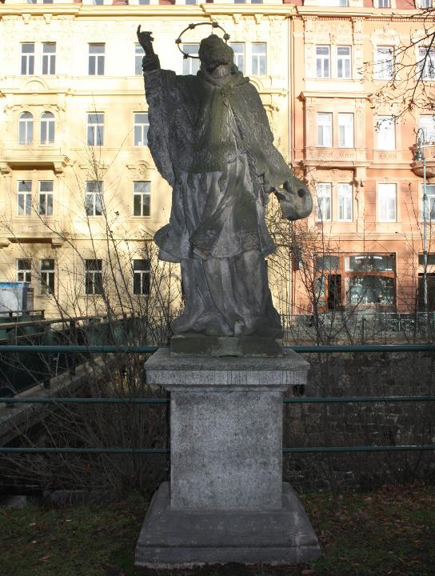
Karlovy
Vary
/Carlsbad

Slide 23
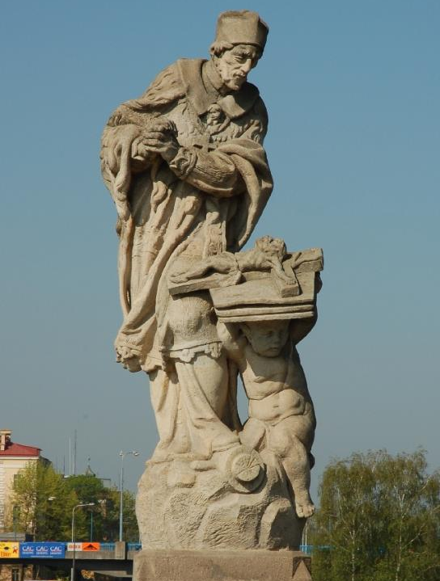
Pilsen
/Plzeň

Slide 24
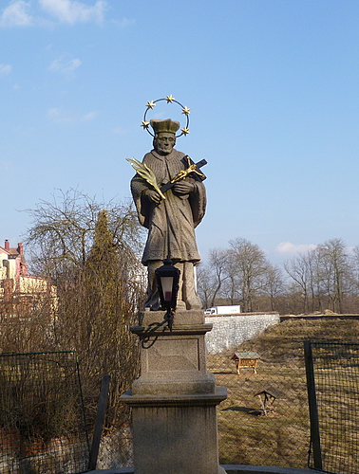
Třeboň

Slide 25
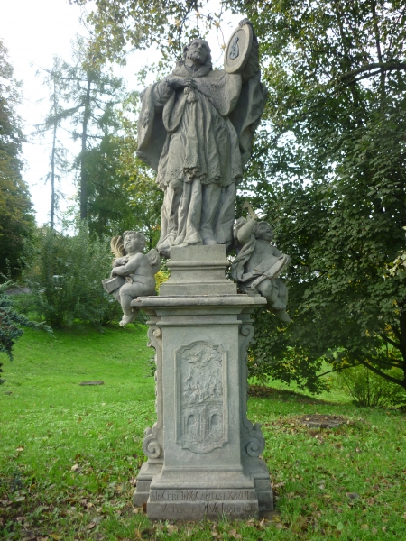
Jihlava

Slide 26
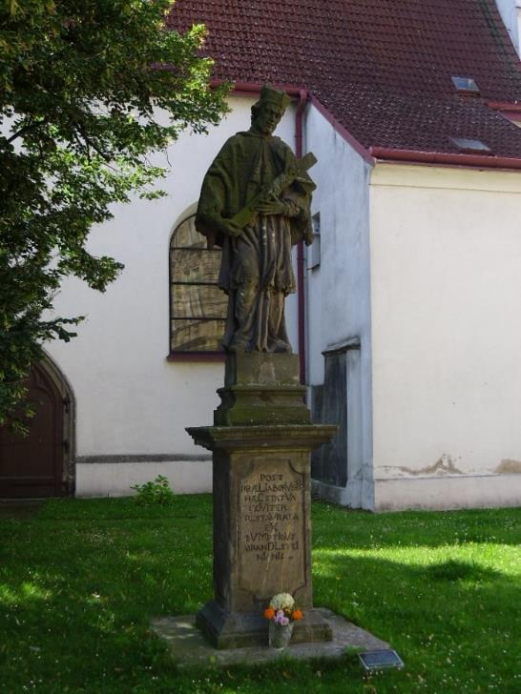
Pardubice

Slide 27
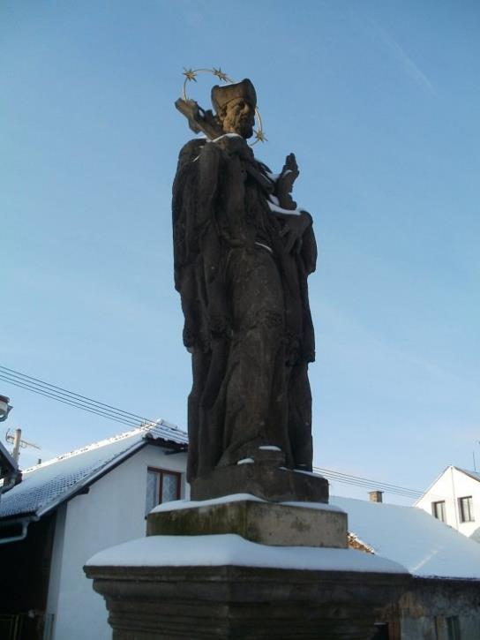
Hradec
Králové

Slide 28
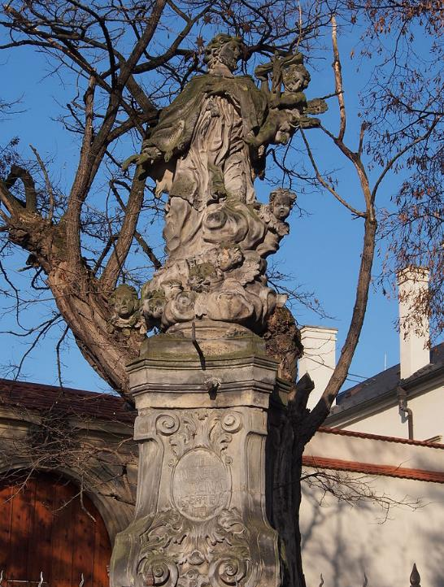
Olomouc

Slide 29
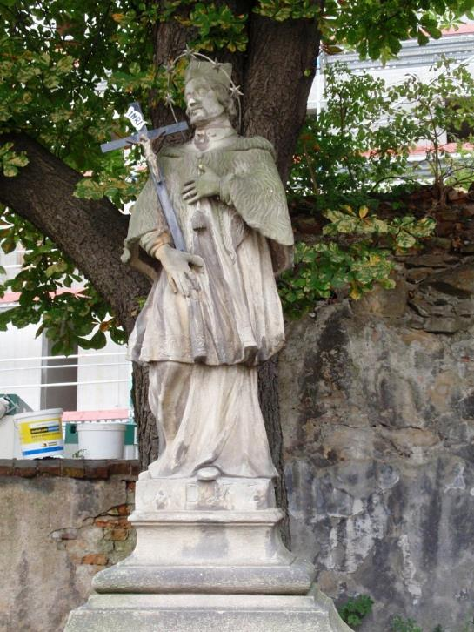
Ostrava

Slide 30
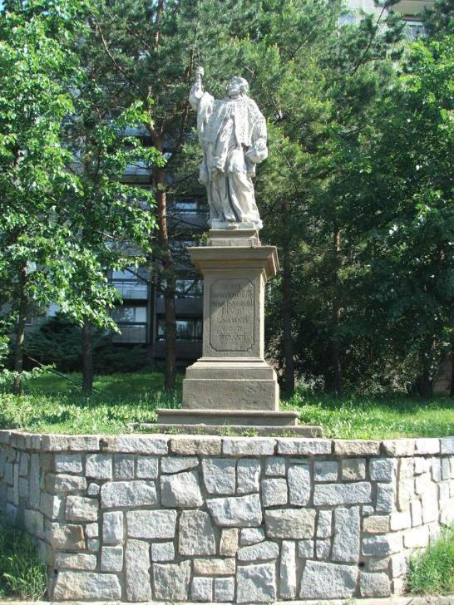
Brno

Slide 31
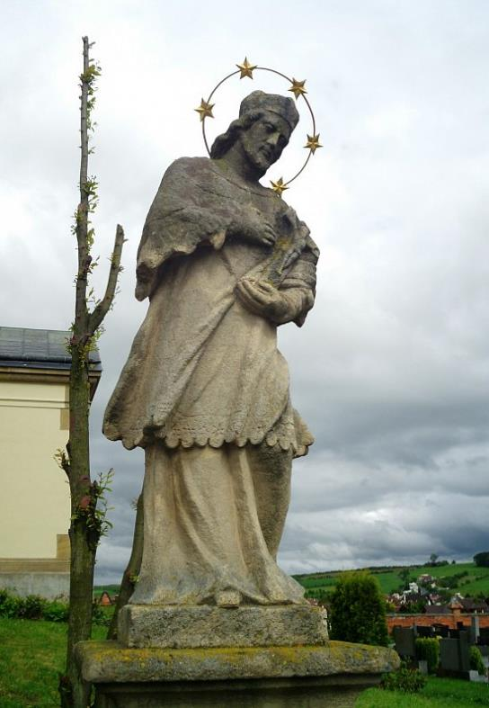
Zlín

